Slide 1
Advanced Angular
Displaying Data and Handling Events
Lecture 2
By James(Jin) Wang
11/15/2021

Slide 2
Outline
Display data
Apply classes / styles dynamically
Format data using pipes
Handle events

Slide 3
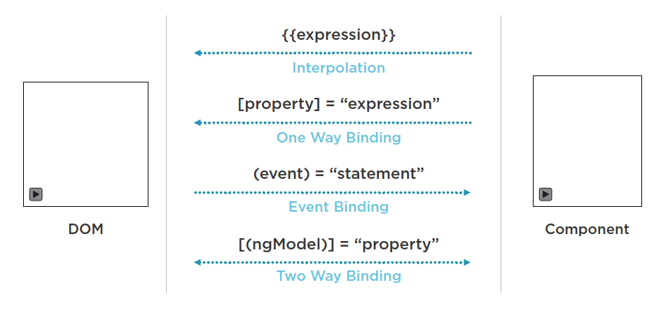
Display data

Slide 4
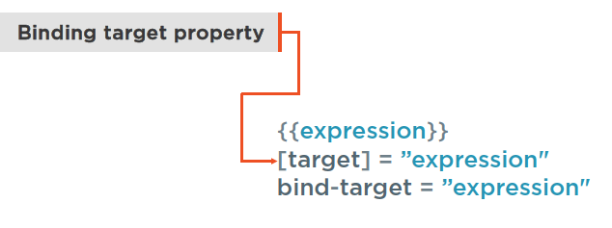
Display data
  Property Binding:
  add <img [src]="imageUrl" /> to property binding

Slide 5
Display data
  Attribute Binding:
  add <td [attr.colspan]=”colspan”> </td> to attribute binding

Slide 6
Apply Classes
  Adding Bootstrap:
  npm install bootstrap --save
  @import "~bootstrap/dist/css/bootstrap.css”;
  <button class="btn btn-primary">Save</button>

Slide 7
Apply Classes
  Class Binding:
  add [class.active]="isActive"

Slide 8
Apply Classes
  Style Binding:
  add [style.backgroundColor]="isActive ? 'blue' : 'orange'"

Slide 9
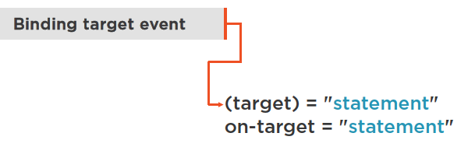
Handle Events
  Event Binding:
  add (click)="onSuccess($event)” to Event binding

Slide 10
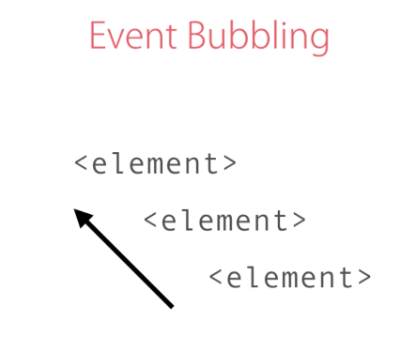
Handle Events
  Event Bubbling:
  add <div (click)="onDivClicked($event)">

Slide 11
Handle Events
  Event Filtering:
  Old:
  <input (keyup)="onKeyUp($event)" />
  New:
  <input (keyup.enter)="onKeyUp()" />

Slide 12
Handle Events
  Template Variables:
  Old:
  <input (keyup.enter)="onKeyUp2($event)" />
  New:
  <input #email (keyup.enter)="onKeyUp2(email.value)" />

Slide 13

Handle Events
  Two-way Binding:
  add <input [(ngModel)]="email" (keyup.enter)="onKeyUp3()" /> to Two-way binding

Slide 14
Format data using Pipes
  Pipes:
  Uppercase
  Lowercase
  Decimal
  Currency
  Percent
  add course = {
  title: "Angular Course”
  }

Slide 15
Format data using Pipes
  Creating Custom Pipes:
  ng g pipe summary-pipe
  add:
  <div>
  {{ text | summaryPipe: 20 }}
  </div>

Slide 16
Summary

Slide 17
Assignment
  1. How would you apply “glyphicon-star” class to an element if “isFavorite” is true?
  2. What access modifier do we use for methods that are internal to a class and should not be visible from the outside?

Slide 18
Self Study
  Angular: Getting Started
  https://app.pluralsight.com/library/courses/angular-2-getting-started-update
  Angular CLI
  https://app.pluralsight.com/library/courses/angular-cli

